Slide 1
CLASS 32 BIAS VARIANCE TRADE OFF UNIT I
BIAS VARIANCE TRADE OFF
Prof. Vineeta Shrivastava
Assistant Professor
Department of Computer Science & Engineering
LNCT-E, Bhopal
Lakshmi Narain College of Technology Excellence, Bhopal

Slide 2
CLASS 32 BIAS VARIANCE TRADE OFF UNIT I
Agenda
Definition
Need of Machine Learning
Traditional Programming v/s Machine Learning
Working of Machine Learning
Applications of Machine Learning
Scope and Limitations of Machine Learning
Prof. Vineeta Shrivastava
Assistant Professor
Department of Computer Science & Engineering
LNCT-E, Bhopal
Lakshmi Narain College of Technology Excellence, Bhopal

Slide 3
CLASS 32 BIAS VARIANCE TRADE OFF UNIT I
The inductive bias (also known as learning bias) of a learning algorithm is the set of assumptions that the learner uses to predict outputs of given inputs that it has not encountered. Inductive bias is anything which makes the algorithm learn one pattern instead of another pattern (e.g. step-functions in decision trees instead of continuous function in a linear regression model.
Prof. Vineeta Shrivastava
Assistant Professor
Department of Computer Science & Engineering
LNCT-E, Bhopal
Lakshmi Narain College of Technology Excellence, Bhopal

Slide 4
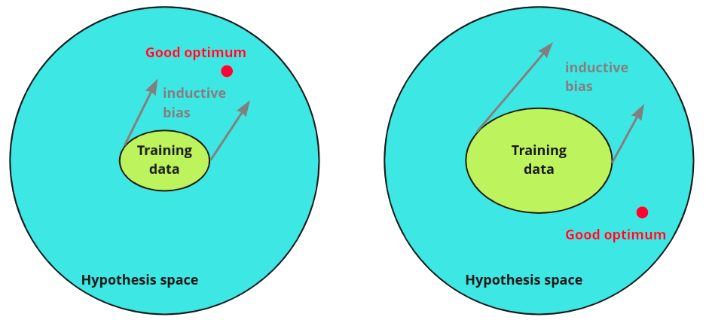
CLASS 32 BIAS VARIANCE TRADE OFF UNIT I
Prof. Vineeta Shrivastava
Assistant Professor
Department of Computer Science & Engineering
LNCT-E, Bhopal
Lakshmi Narain College of Technology Excellence, Bhopal

Slide 5
CLASS 32 BIAS VARIANCE TRADE OFF UNIT I
The bias-variance tradeoff is a fundamental concept in machine learning that describes the balance between two sources of error that affect a model's performance: bias and variance.
Bias is simply defined as the inability of the model because of that there is some difference or error occurring between the model’s predicted value and the actual value. These differences between actual or expected values and the predicted values are known as error or bias error or error due to bias. Bias is a systematic error that occurs due to wrong assumptions in the machine learning process.
Prof. Vineeta Shrivastava
Assistant Professor
Department of Computer Science & Engineering
LNCT-E, Bhopal
Lakshmi Narain College of Technology Excellence, Bhopal

Slide 6
CLASS 32 BIAS VARIANCE TRADE OFF UNIT I
Bias:
Definition: Bias refers to the error introduced by approximating a real-world problem, which may be complex, by a much simpler model.
High Bias: A model with high bias makes strong assumptions about the data. It might be too simple, leading to underfitting. This means the model fails to capture the underlying patterns in the data.
Example: A linear model used to fit nonlinear data might have high bias because it cannot capture the curvature of the data
Prof. Vineeta Shrivastava
Assistant Professor
Department of Computer Science & Engineering
LNCT-E, Bhopal
Lakshmi Narain College of Technology Excellence, Bhopal

Slide 7
CLASS 32 BIAS VARIANCE TRADE OFF UNIT I
Variance:
Definition: Variance refers to the error introduced by the model’s sensitivity to fluctuations in the training data.
High Variance: A model with high variance pays too much attention to the training data, capturing noise along with the underlying patterns. This leads to overfitting, where the model performs well on the training data but poorly on new data.
Example: A very deep decision tree might have high variance because it splits the data until it perfectly fits the training set, including its noise.
Prof. Vineeta Shrivastava
Assistant Professor
Department of Computer Science & Engineering
LNCT-E, Bhopal
Lakshmi Narain College of Technology Excellence, Bhopal

Slide 8
CLASS 32 BIAS VARIANCE TRADE OFF UNIT I
2. The Tradeoff
Bias-Variance Tradeoff: There is a tradeoff between bias and variance; as you decrease bias, variance usually increases, and vice versa.
High Bias, Low Variance: The model is simple, and it might miss relevant relations between features and target outputs (underfitting). It consistently performs poorly on training data and unseen data.
Low Bias, High Variance: The model is complex, capturing the idiosyncrasies of the training data (overfitting). It performs well on the training data but poorly on unseen data due to its sensitivity to data fluctuations.
Optimal Point: The goal is to find a balance where the model has low enough bias to capture important patterns and low enough variance to generalize well to new data.
Prof. Vineeta Shrivastava
Assistant Professor
Department of Computer Science & Engineering
LNCT-E, Bhopal
Lakshmi Narain College of Technology Excellence, Bhopal

Slide 9
CLASS 32 BIAS VARIANCE TRADE OFF UNIT I
5. Mitigating the Bias-Variance Tradeoff
To manage the bias-variance tradeoff:
Cross-Validation: Use cross-validation to estimate how your model will perform on unseen data, helping you choose the right level of complexity.
Regularization: Techniques like L1 (Lasso) and L2 (Ridge) regularization can penalize model complexity, reducing variance without increasing bias too much.
Ensemble Methods: Combining multiple models (e.g., bagging, boosting) can reduce variance without significantly increasing bias.
Prof. Vineeta Shrivastava
Assistant Professor
Department of Computer Science & Engineering
LNCT-E, Bhopal
Lakshmi Narain College of Technology Excellence, Bhopal

Slide 10
CLASS 32 BIAS VARIANCE TRADE OFF UNIT I
The bias-variance tradeoff is a crucial concept in model selection and tuning. The key to building effective machine learning models lies in understanding and balancing these two sources of error, aiming for a model that generalizes well to new data by appropriately managing bias and variance.
Prof. Vineeta Shrivastava
Assistant Professor
Department of Computer Science & Engineering
LNCT-E, Bhopal
Lakshmi Narain College of Technology Excellence, Bhopal

Slide 11
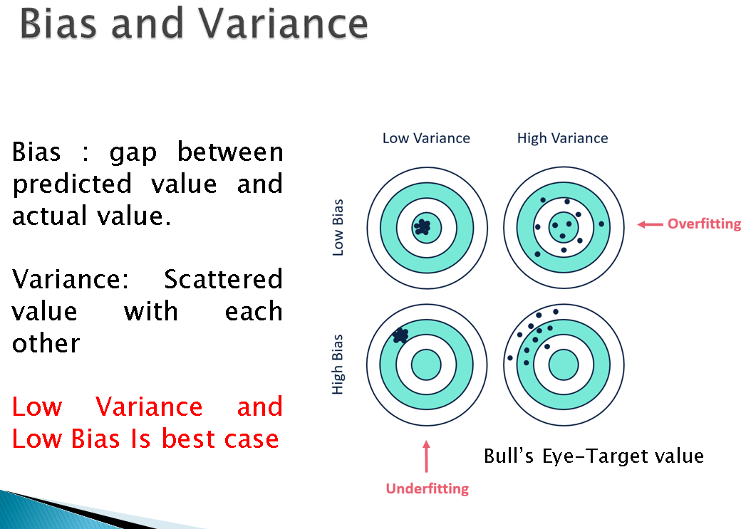
CLASS 32 BIAS VARIANCE TRADE OFF UNIT I
Prof. Vineeta Shrivastava
Assistant Professor
Department of Computer Science & Engineering
LNCT-E, Bhopal
Lakshmi Narain College of Technology Excellence, Bhopal

Slide 12
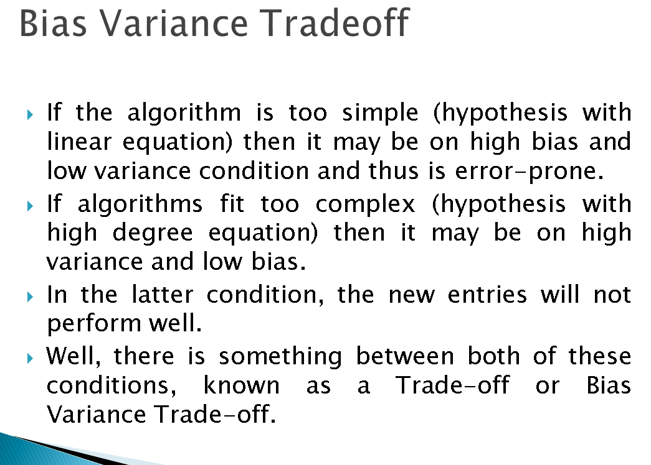
CLASS 32 BIAS VARIANCE TRADE OFF UNIT I
Prof. Vineeta Shrivastava
Assistant Professor
Department of Computer Science & Engineering
LNCT-E, Bhopal
Lakshmi Narain College of Technology Excellence, Bhopal

Slide 13
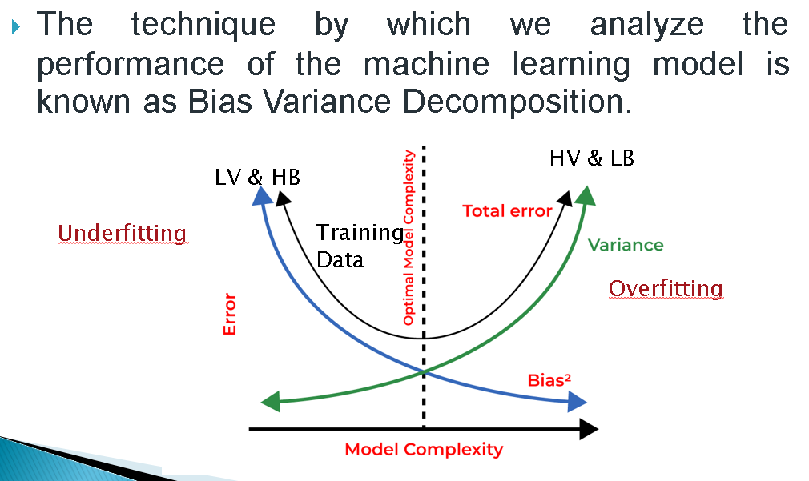
CLASS 32 BIAS VARIANCE TRADE OFF UNIT I
Prof. Vineeta Shrivastava
Assistant Professor
Department of Computer Science & Engineering
LNCT-E, Bhopal
Lakshmi Narain College of Technology Excellence, Bhopal

Slide 14
CLASS 32 BIAS VARIANCE TRADE OFF UNIT I
Difference Between AL,ML,DL and DS
The terms Artificial Intelligence (AI), Machine Learning (ML), Deep Learning (DL), and Data Science (DS) are often used interchangeably but refer to distinct concepts in the field of data analysis and computational intelligence.
Prof. Vineeta Shrivastava
Assistant Professor
Department of Computer Science & Engineering
LNCT-E, Bhopal
Lakshmi Narain College of Technology Excellence, Bhopal

Slide 15
CLASS 32 BIAS VARIANCE TRADE OFF UNIT I
Artificial Intelligence (AI)
Definition: AI is the broadest concept, encompassing all techniques that enable computers to mimic human intelligence. It includes any method that allows a machine to perform tasks that would typically require human intelligence, such as reasoning, problem-solving, understanding language, and recognizing patterns.
Scope: AI covers a wide range of subfields, including ML, DL, robotics, natural language processing (NLP), computer vision, expert systems, and more.
Example: AI includes systems like chatbots, virtual assistants (e.g., Siri, Alexa), and self-driving cars.
Prof. Vineeta Shrivastava
Assistant Professor
Department of Computer Science & Engineering
LNCT-E, Bhopal
Lakshmi Narain College of Technology Excellence, Bhopal

Slide 16
CLASS 32 BIAS VARIANCE TRADE OFF UNIT I
Machine Learning (ML)
Definition: ML is a subset of AI that focuses on building algorithms that allow computers to learn from and make decisions based on data. Instead of being explicitly programmed for a task, ML models identify patterns in data and use them to make predictions or decisions.
Scope: ML includes various techniques such as supervised learning, unsupervised learning, semi-supervised learning, and reinforcement learning.
Example: An email spam filter is an ML model that learns to recognize spam emails based on patterns learned from past data.
Prof. Vineeta Shrivastava
Assistant Professor
Department of Computer Science & Engineering
LNCT-E, Bhopal
Lakshmi Narain College of Technology Excellence, Bhopal

Slide 17
CLASS 32 BIAS VARIANCE TRADE OFF UNIT I
Deep Learning (DL)
Definition: DL is a subset of ML that uses neural networks with many layers (hence “deep”) to model complex patterns in large datasets. DL algorithms are particularly powerful for tasks involving high-dimensional data such as images, audio, and text.
Scope: DL is focused on neural networks, including Convolutional Neural Networks (CNNs), Recurrent Neural Networks (RNNs), and Generative Adversarial Networks (GANs).
Example: DL is used in facial recognition systems, speech recognition (like in virtual assistants), and advanced image processing.
Prof. Vineeta Shrivastava
Assistant Professor
Department of Computer Science & Engineering
LNCT-E, Bhopal
Lakshmi Narain College of Technology Excellence, Bhopal

Slide 18
CLASS 32 BIAS VARIANCE TRADE OFF UNIT I
Data Science (DS)
Definition: DS is an interdisciplinary field that involves using scientific methods, processes, algorithms, and systems to extract knowledge and insights from structured and unstructured data. It combines aspects of statistics, data analysis, machine learning, and domain expertise.
Scope: DS encompasses the entire process of gathering, cleaning, processing, analyzing, and interpreting data. It often includes ML as a tool for analyzing data but is broader, including traditional statistical methods and data management.
Example: A data scientist might analyze customer behavior data to identify trends, predict future purchasing patterns, and inform business decisions.
Prof. Vineeta Shrivastava
Assistant Professor
Department of Computer Science & Engineering
LNCT-E, Bhopal
Lakshmi Narain College of Technology Excellence, Bhopal

Slide 19
CLASS 32 BIAS VARIANCE TRADE OFF UNIT I
Key Differences and Relationships:
AI is the umbrella term that includes any method that enables a machine to simulate human intelligence. ML is a subset of AI focused specifically on the ability of machines to learn from data. DL is a specialized subset of ML that deals with neural networks with many layers, designed to handle complex tasks. DS is a broader field focused on extracting insights from data and often employs ML as one of its tools.
Prof. Vineeta Shrivastava
Assistant Professor
Department of Computer Science & Engineering
LNCT-E, Bhopal
Lakshmi Narain College of Technology Excellence, Bhopal

Slide 20
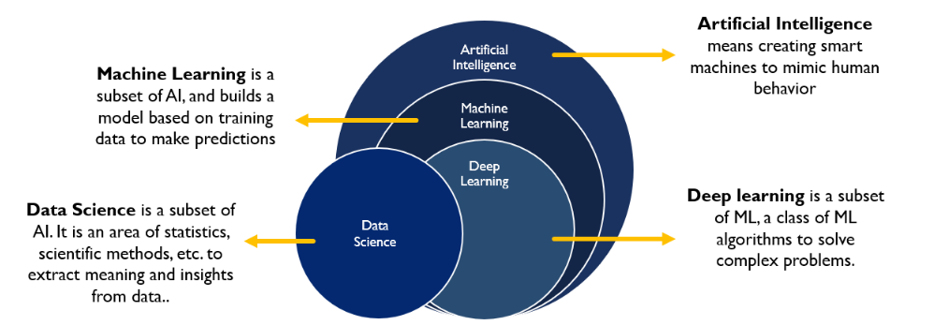
CLASS 32 BIAS VARIANCE TRADE OFF UNIT I
Prof. Vineeta Shrivastava
Assistant Professor
Department of Computer Science & Engineering
LNCT-E, Bhopal
Lakshmi Narain College of Technology Excellence, Bhopal

Slide 21
CLASS 32 BIAS VARIANCE TRADE OFF UNIT I
Summary:
AI: The broad field of creating systems that can perform tasks that require human intelligence.
ML: A subset of AI focused on algorithms that learn from data.
DL: A further subset of ML involving deep neural networks, especially for complex data.
DS: The field of extracting insights from data, often using ML and AI techniques.
Prof. Vineeta Shrivastava
Assistant Professor
Department of Computer Science & Engineering
LNCT-E, Bhopal
Lakshmi Narain College of Technology Excellence, Bhopal

Slide 22
CLASS 32 BIAS VARIANCE TRADE OFF UNIT I
THANKYOU
Prof. Vineeta Shrivastava
Assistant Professor
Department of Computer Science & Engineering
LNCT-E, Bhopal
Lakshmi Narain College of Technology Excellence, Bhopal

